Slide 1
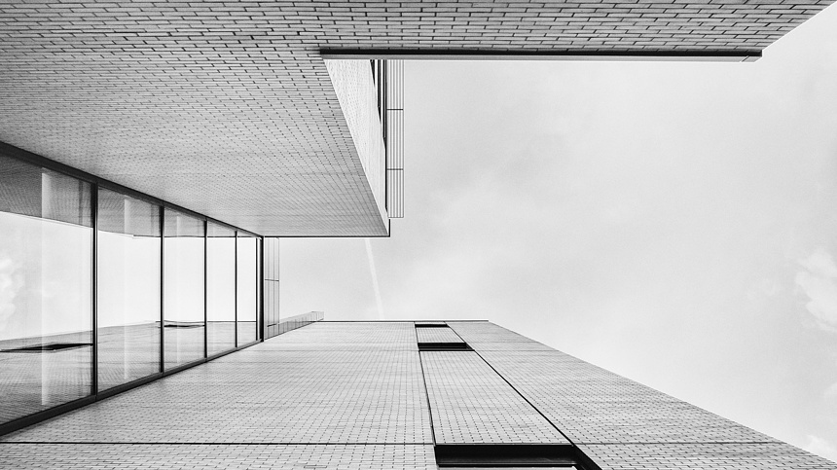

题目：Zooming Slow-Mo: Fast
and Accurate One-Stage
Space-Time Video Super-Resolution
来源：CVPR2020
汇报人：程日
Notes:
Zooming Slow-Mo
Fast and Accurate
One-Stage Space-Time Video Super-Resolution

Slide 2

01
背景与相关工作
02
贡献
目录
CONTNETS
03
模型
04
实验结果

Slide 3
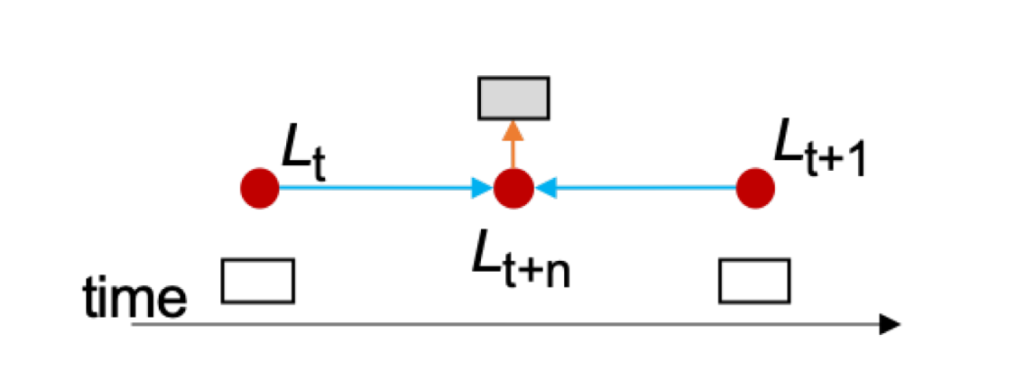

背景与相关工作
Video Frame Interpolation (VFI)
The target of video frame interpolation is to synthesize non-existent intermediate frames in between the original frames.
Our: Interpolate features from two neighboring low-resolution (LR) frames, rather than synthesizing the intermediate LR frames.
Notes:
视频帧插入（VFI）的目标是在原始帧之间合成不存在的中间帧。
这篇时空超分辨率任务也用到了视频帧插入的思想

Slide 4
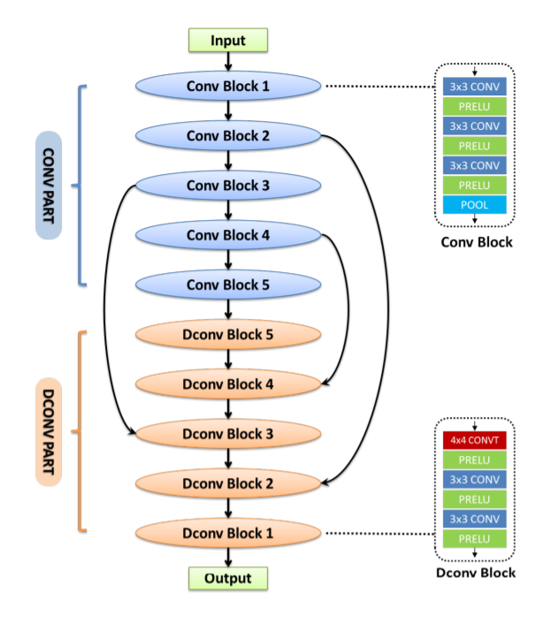
背景与相关工作
Video Frame Interpolation (VFI)
Working on VFI:
Directly with an encoder-decoder CNN^{[1]}
Learn a spatially adaptive convolution kernel ^{[2]}
Flow-based video interpolation approaches^{[3,4,5,6]}
^{[1]} Gucan Long, Laurent Kneip, Jose M Alvarez, Hongdong Li, Xiaohu Zhang, and Qi fengYu. Learning image matching by simply watching video. ECCV 2016
^{[2]} Simon Niklaus, Long Mai, and Feng Liu. Video frame interpolation via adaptive convolution. CVPR 2017
^{[3]} Huaizu Jiang, Deqing Sun, Varun Jampani, Ming-Hsuan Yang, Erik Learned-Miller, and Jan Kautz. Super slomo: High quality estimation of multiple intermediate frames for video interpolation. CVPR 2018
^{[4]} Ziwei Liu, Raymond A Yeh, Xiaoou Tang, Yiming Liu, and Aseem Agarwala. Video frame synthesis using deep voxel ﬂow. ICCV 2017
^{[5]} Wenbo Bao, Wei-Sheng Lai, Chao Ma, Xiaoyun Zhang, Zhiyong Gao, and Ming-Hsuan Yang. Depth-aware video frame interpolation. CVPR 2019
^{[6]} Wenbo Bao, Wei-Sheng Lai, Xiaoyun Zhang, Zhiyong Gao, and Ming-Hsuan Yang. Memc-net: Motion estimation and motion compensation driven neural network for video interpolation and enhancement. TPAMI 2019
Notes:
做视频插针的研究有很多，基于深度学习网络的研究有以下几种类型

Slide 5
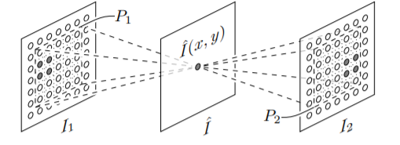
背景与相关工作
Video Frame Interpolation (VFI)
Working on VFI:
Directly with an encoder-decoder CNN^{[1]}
Learn a spatially adaptive convolution kernel ^{[2]}
Flow-based video interpolation approaches^{[3,4,5,6]}
^{[1]} Gucan Long, Laurent Kneip, Jose M Alvarez, Hongdong Li, Xiaohu Zhang, and Qi fengYu. Learning image matching by simply watching video. ECCV 2016
^{[2]} Simon Niklaus, Long Mai, and Feng Liu. Video frame interpolation via adaptive convolution. CVPR 2017
^{[3]} Huaizu Jiang, Deqing Sun, Varun Jampani, Ming-Hsuan Yang, Erik Learned-Miller, and Jan Kautz. Super slomo: High quality estimation of multiple intermediate frames for video interpolation. CVPR 2018
^{[4]} Ziwei Liu, Raymond A Yeh, Xiaoou Tang, Yiming Liu, and Aseem Agarwala. Video frame synthesis using deep voxel ﬂow. ICCV 2017
^{[5]} Wenbo Bao, Wei-Sheng Lai, Chao Ma, Xiaoyun Zhang, Zhiyong Gao, and Ming-Hsuan Yang. Depth-aware video frame interpolation. CVPR 2019
^{[6]} Wenbo Bao, Wei-Sheng Lai, Xiaoyun Zhang, Zhiyong Gao, and Ming-Hsuan Yang. Memc-net: Motion estimation and motion compensation driven neural network for video interpolation and enhancement. TPAMI 2019

Slide 6
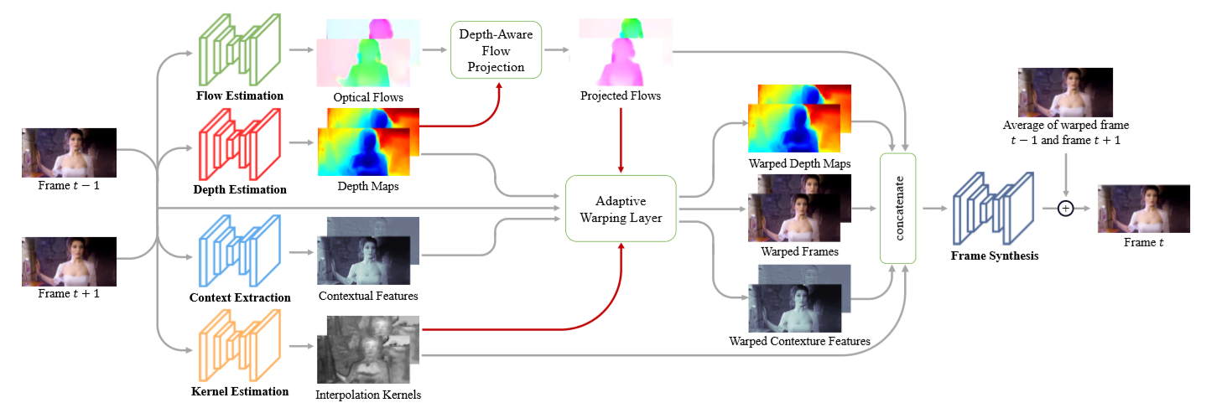
背景与相关工作
Video Frame Interpolation (VFI)
Working on VFI:
Directly with an encoder-decoder CNN^{[1]}
Learn a spatially adaptive convolution kernel ^{[2]}
Flow-based video interpolation approaches^{[3,4,5,6]}
Inaccuracies and missing information from optical flow results.
^{[1]} Gucan Long, Laurent Kneip, Jose M Alvarez, Hongdong Li, Xiaohu Zhang, and Qi fengYu. Learning image matching by simply watching video. ECCV 2016
^{[2]} Simon Niklaus, Long Mai, and Feng Liu. Video frame interpolation via adaptive convolution. CVPR 2017
^{[3]} Huaizu Jiang, Deqing Sun, Varun Jampani, Ming-Hsuan Yang, Erik Learned-Miller, and Jan Kautz. Super slomo: High quality estimation of multiple intermediate frames for video interpolation. CVPR 2018
^{[4]} Ziwei Liu, Raymond A Yeh, Xiaoou Tang, Yiming Liu, and Aseem Agarwala. Video frame synthesis using deep voxel ﬂow. ICCV 2017
^{[5]} Wenbo Bao, Wei-Sheng Lai, Chao Ma, Xiaoyun Zhang, Zhiyong Gao, and Ming-Hsuan Yang. Depth-aware video frame interpolation. CVPR 2019
^{[6]} Wenbo Bao, Wei-Sheng Lai, Xiaoyun Zhang, Zhiyong Gao, and Ming-Hsuan Yang. Memc-net: Motion estimation and motion compensation driven neural network for video interpolation and enhancement. TPAMI 2019
Notes:
In our one-stage STVSR framework, rather than synthesizing the intermediate LR frames as current VFI methods do, we interpolate features from two neighboring LR frames to directly synthesize LR feature maps for missing frames without requiring explicit supervision.
在我们的单阶段STVSR框架中，我们没有像目前的VFI方法那样合成中间的LR帧，而是从两个相邻的LR帧中插值特征，从而直接合成缺失的LR特征映射，而不需要明确的监督。

Slide 7
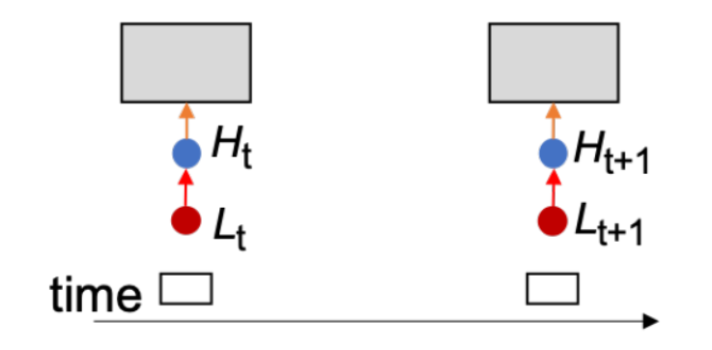
背景与相关工作
Video Super-Resolution (VSR)
Video super-resolution aims to reconstruct an high-resolution (HR) video frame from the corresponding low-resolution (LR) frame (reference frame) and its neighboring LR frames (supporting frames).

Slide 8
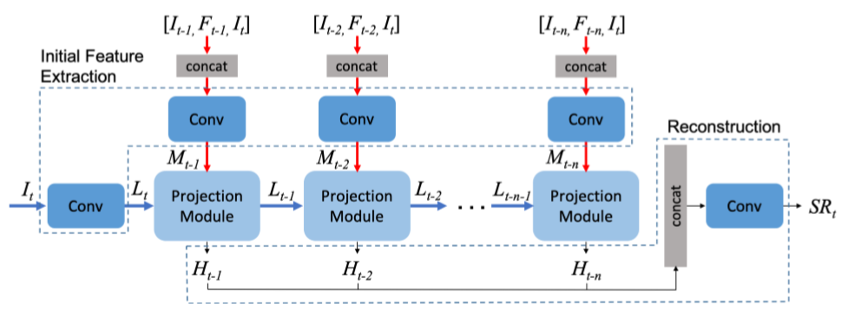
背景与相关工作
Video Super-Resolution (VSR)
Working on VSR:
Use optical ﬂow for explicit temporal alignment ^{[7]}
Dynamic ﬁlters / deformable alignment ^{[8, 9]}
Sequence-to-sequence (S2S) learning^{[10]}
Difﬁcult to obtain accurate ﬂow; and ﬂow warping also introduces artifacts
^{[7]} Muhammad Haris, Gregory Shakhnarovich, and Norimichi Ukita. Recurrent back-projection network for video super resolution. CVPR 2019
^{[8]} Younghyun Jo, Seoung Wug Oh, Jaeyeon Kang, and Seon Joo Kim. Deep video super-resolution network using dynamic upsampling ﬁlters without explicit motion compensation. CVPR 2018
^{[9]} Yapeng Tian, Yulun Zhang, Yun Fu, and Chenliang Xu. Tdan: Temporally deformable alignment network for video super-resolution. CVPR 2020
^{[10]} Yan Huang, Wei Wang, and Liang Wang. Video superresolution via bidirectional recurrent convolutional networks. TPAMI 2017

Slide 9
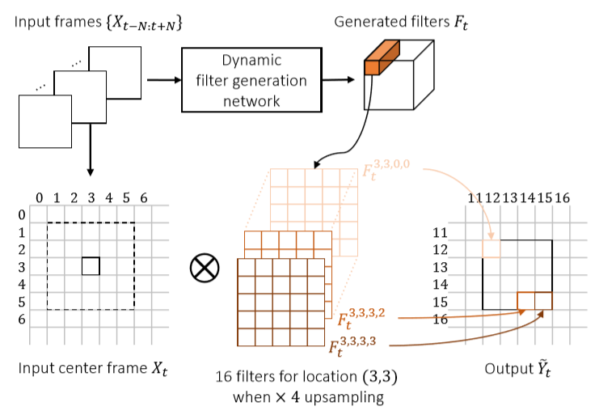
背景与相关工作
Video Super-Resolution (VSR)
Working on VSR:
Use optical ﬂow for explicit temporal alignment ^{[7]}
Dynamic ﬁlters / deformable alignment ^{[8, 9]}
Sequence-to-sequence (S2S) learning^{[10]}
Many-to-one architectures; computationally inefﬁcient.
^{[7]} Muhammad Haris, Gregory Shakhnarovich, and Norimichi Ukita. Recurrent back-projection network for video super resolution. CVPR 2019
^{[8]} Younghyun Jo, Seoung Wug Oh, Jaeyeon Kang, and Seon Joo Kim. Deep video super-resolution network using dynamic upsampling ﬁlters without explicit motion compensation. CVPR 2018
^{[9]} Yapeng Tian, Yulun Zhang, Yun Fu, and Chenliang Xu. Tdan: Temporally deformable alignment network for video super-resolution. CVPR 2020
^{[10]} Yan Huang, Wei Wang, and Liang Wang. Video superresolution via bidirectional recurrent convolutional networks. TPAMI 2017
Notes:
但是，以上大多数方法都是多对一的体系结构，它们需要处理一批低分辨率（LR）帧来预测一个高分辨率（HR）帧，这使得这些方法在计算上没有效率。循环神经网络，例如卷积LSTM [39]（ConvLSTM），可以简化序列到序列（S2S）学习。
方法[17，18]中采用了它们来利用时间信息进行视频超分辨率（VSR）。但是，如果没有明确的时间对齐，基于循环神经网络的视频超分辨率（VSR）网络在处理视频中很大的、复杂运动方面的能力有限。

Slide 10
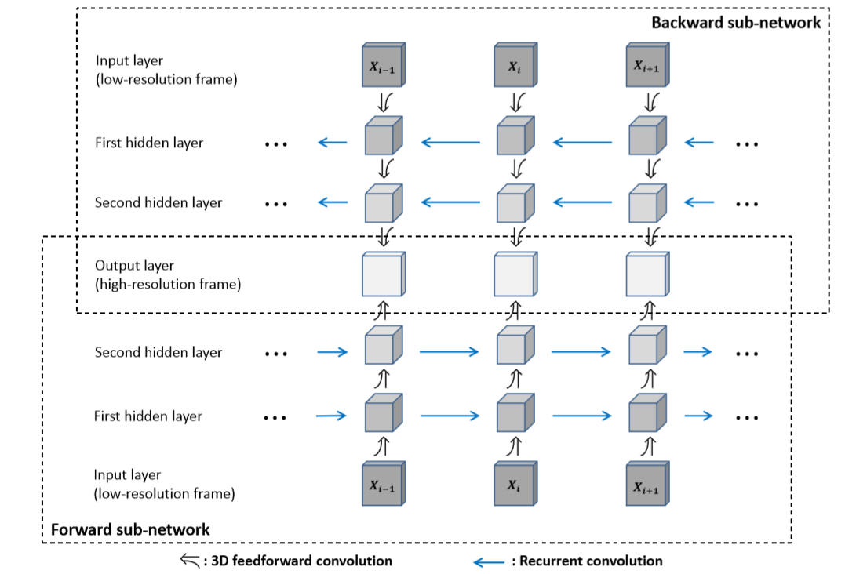
背景与相关工作
Video Super-Resolution (VSR)
Working on VSR:
Use optical ﬂow for explicit temporal alignment ^{[7]}
Dynamic ﬁlters / deformable alignment ^{[8, 9]}
Sequence-to-sequence (S2S) learning^{[10]}
Without explicit temporal alignment, have limited capability in handling large and complex motions within videos.
^{[10]} Yan Huang, Wei Wang, and Liang Wang. Video superresolution via bidirectional recurrent convolutional networks. TPAMI 2017
Notes:
但是，以上大多数方法都是多对一的体系结构，它们需要处理一批低分辨率（LR）帧来预测一个高分辨率（HR）帧，这使得这些方法在计算上没有效率。循环神经网络，例如卷积LSTM [39]（ConvLSTM），可以简化序列到序列（S2S）学习。
方法[17，18]中采用了它们来利用时间信息进行视频超分辨率（VSR）。但是，如果没有明确的时间对齐，基于循环神经网络的视频超分辨率（VSR）网络在处理视频中很大的、复杂运动方面的能力有限。

Slide 11
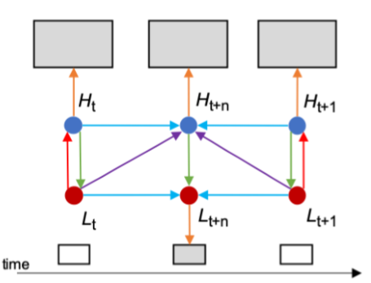
背景与相关工作
Space-Time Video Super-Resolution (STVSR)
Propose a more efﬁcient and effective one-stage framework that simultaneously learns temporal feature interpolation and spatial SR without accessing to LR intermediate frames as supervision.
Difficulty: since pixels are missing in LR frames and even several entire LR frames are unavailable, STVSR is a highly ill-posed inverse problem.
Relation

Slide 12
背景与相关工作
Space-Time Video Super-Resolution (STVSR)
^{[11]} Eli Shechtman, Yaron Caspi, and Michal Irani. Increasing space-time resolution in video. ECCV 2002
^{[12]} Uma Mudenagudi, Subhashis Banerjee, and Prem Kumar Kalra. Space-time super-resolution using graph-cut optimization. TPAMI 2010
^{[13]} Oded Shahar, Alon Faktor, and Michal Irani. Space-time super-resolution from a single video. CVPR 2011
However, these methods have limited capacity to model rich and complex space-time visual patterns, and the optimization for these methods is usually computationally expensive.

Slide 13
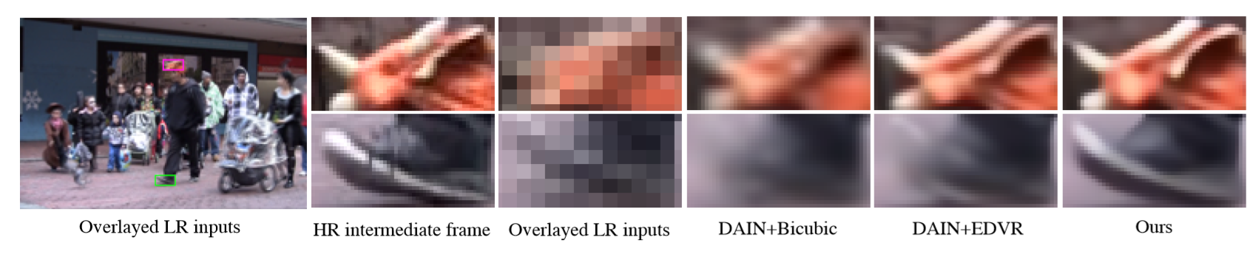
贡献
Contribution
We propose a one-stage space-time super-resolution network that can address temporal interpolation and spatial SR simultaneously in a uniﬁed framework.
Our one-stage method is more effective and computationally more efﬁcient than two-stage methods state-of-the-art two-stage approaches.

Slide 14
贡献
Contribution
We propose a frame feature temporal interpolation network leveraging local temporal contexts based on deformable sampling for intermediate LR features. We devise a novel deformable ConvLSTM to explicitly enhance temporal alignment capacity and exploit global temporal contexts for handling large motions in videos.
Notes:
因为没有gt的Lrframe，加强网络
更改时间网络，更好地聚集信息，去预测。

Slide 15
贡献
Contribution
Our one stage method achieves state-of-the-art STVSR performance on both Vid4^{[14]} and Vimeo^{[15]}. It is 3 times faster than the two-stage network: DAIN^{[5]} + EDVR^{[16]} while having a nearly 4× reduction in model size.
^{[14]} Ce Liu and Deqing Sun. A bayesian approach to adaptive video super resolution. CVPR 2011
^{[15]} Tianfan Xue, Baian Chen, Jiajun Wu, Donglai Wei, and William T Freeman. Video enhancement with taskoriented ﬂow. IJCV 2019
^{[16]} Xintao Wang, Kelvin CK Chan, Ke Yu, Chao Dong, and Chen Change Loy. Edvr: Video restoration with enhanced deformable convolutional networks. CVPR 2019

Slide 16
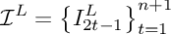
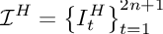
模型
General introduction
Increase resolution in both space and time domains.
The framework mainly consists of four parts: feature extractor, frame feature temporal interpolation module, deformable ConvLSTM, and HR frame reconstructor.

Slide 17
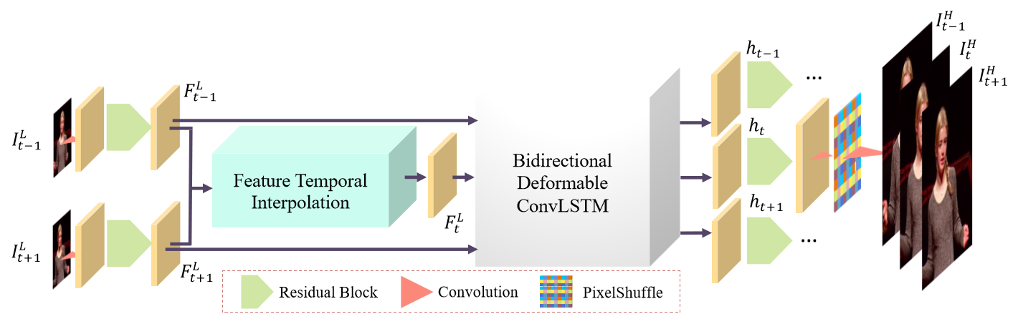
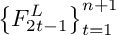
模型
Feature Extractor
Notes:
We ﬁrst use a feature extractor with a convolutional layer and k1 residual blocks to extract feature maps

Slide 18
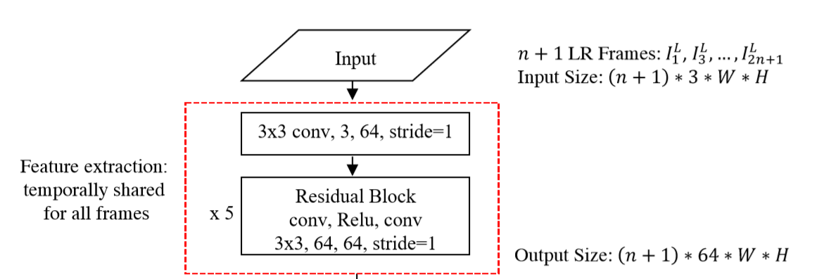
模型
Feature Extractor
Notes:
We ﬁrst use a feature extractor with a convolutional layer and k1 residual blocks to extract feature maps

Slide 19
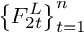
模型
Feature Temporal Interpolation

Slide 20
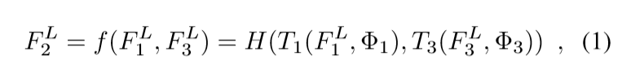
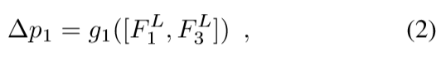


模型
Feature Temporal Interpolation
Notes:
Forward and backward motion information
F2 is not available，不能显式地进行监督，去提取特征
we propose to use deformable sampling functions to implicitly capture motion information for frame feature temporal interpolation. With exploring rich local temporal contexts by deformable convolutions in sampling functions, our feature temporal interpolation can even handle very large motions in videos.

Slide 21
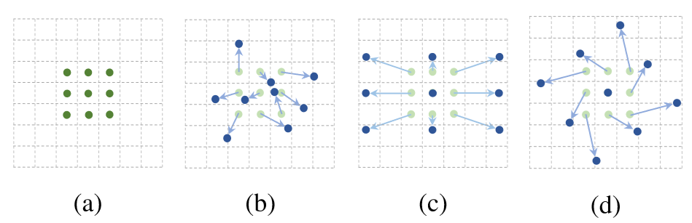
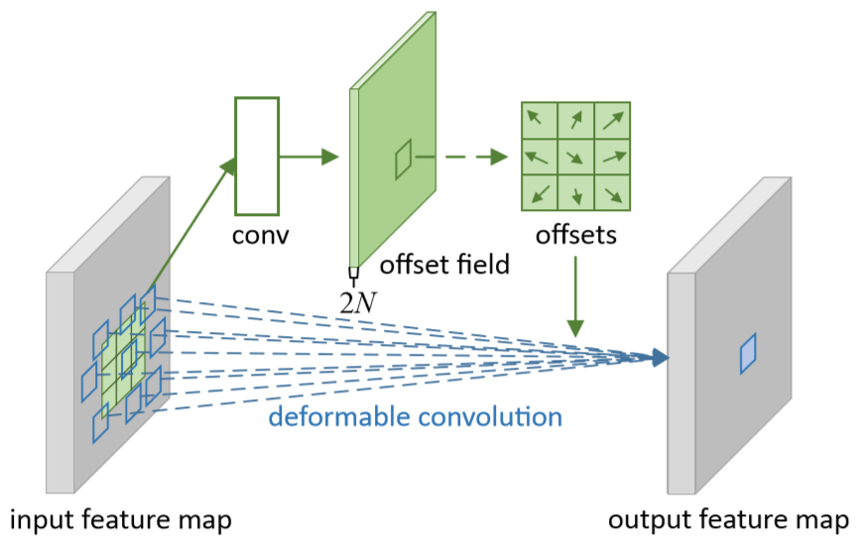
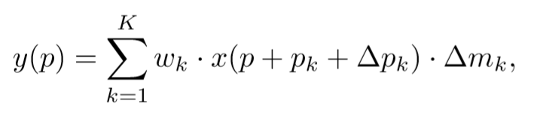
模型
Feature Temporal Interpolation ----
Deformable convolution ^{[18,} ^{19]}
Convolutional neural networks (CNNs): ﬁxed geometric structures.
V1^{[18]}: Augmenting the spatial sampling locations in the modules: offsets.
V2^{[19]}: Learn the modulation of each sampling point.
^{[18]} Jifeng Dai, Haozhi Qi, Yuwen Xiong, Yi Li, Guodong Zhang, Han Hu, and Yichen Wei. Deformable convolutional networks. In Proceedings of the IEEE International Conference on Computer Vision, pages 764–773, 2017.
^{[19]} Xizhou Zhu, Han Hu, Stephen Lin, and Jifeng Dai. Deformable convnets v2: More deformable, better results. In Proceedings of the IEEE Conference on Computer Vision and Pattern Recognition, pages 9308–9316, 2019.
Notes:
Forward and backward motion information
F2 is not available
we propose to use deformable sampling functions to implicitly capture motion information for frame feature temporal interpolation. With exploring rich local temporal contexts by deformable convolutions in sampling functions, our feature temporal interpolation can even handle very large motions in videos.

Slide 22
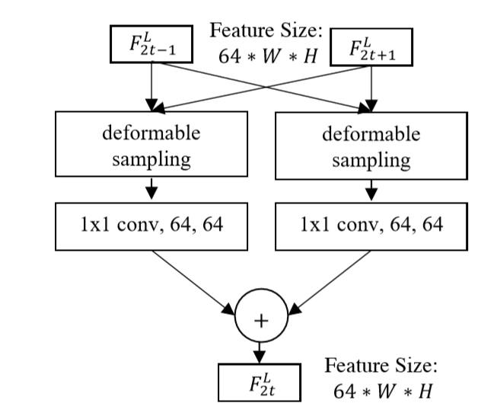
模型
Feature Temporal Interpolation
Notes:
Forward and backward motion information
F2 is not available
we propose to use deformable sampling functions to implicitly capture motion information for frame feature temporal interpolation. With exploring rich local temporal contexts by deformable convolutions in sampling functions, our feature temporal interpolation can even handle very large motions in videos.

Slide 23
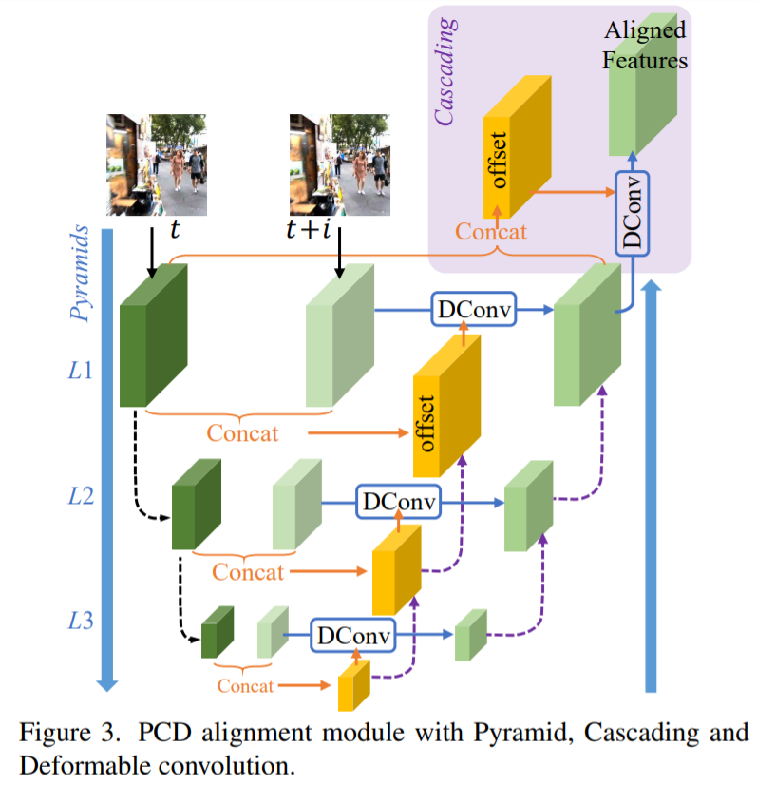
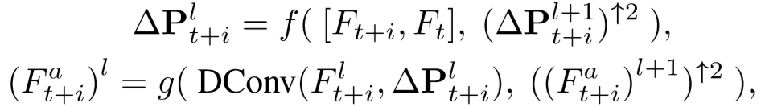
模型
Feature Temporal Interpolation
---- Pyramid, Cascading and Deformable
(PCD) structure^{[17]}
^{[17]} Xintao Wang, Kelvin CK Chan, Ke Yu, Chao Dong, and Chen Change Loy.
Edvr: Video restoration with enhanced deformable convolutional networks.
In Proceedings of the IEEE Conference on Computer Vision and Pattern
Recognition Workshops, pages 0–0, 2019.
Notes:
Forward and backward motion information
F2 is not available
we propose to use deformable sampling functions to implicitly capture motion information for frame feature temporal interpolation. With exploring rich local temporal contexts by deformable convolutions in sampling functions, our feature temporal interpolation can even handle very large motions in videos.

Slide 24
模型
Deformable ConvLSTM
Temporal information is vital, we aggregate temporal contexts from neighboring frames.
Notes:
It has been proved in previous video restoration tasks [40, 34, 37] that temporal information is vital. Therefore, rather than reconstructing HR frames from the corresponding individual feature maps, we aggregate temporal contexts from neighboring frames.

Slide 25
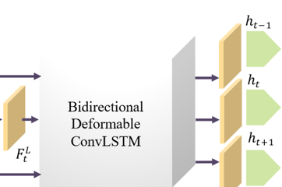
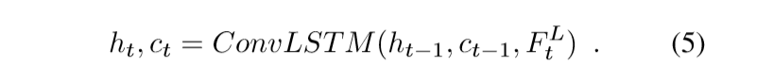
模型
Deformable ConvLSTM
ConvLSTM can only implicitly capture motions between previous states: h_{t−1} and c_{t−1} and the current input feature map with small convolution receptive ﬁelds.
To tackle the large motion problem and effectively exploit global temporal contexts, we explicitly embed a state-updating cell with deformable alignment into ConvLSTM.
Notes:
It has been proved in previous video restoration tasks [40, 34, 37] that temporal information is vital. Therefore, rather than reconstructing HR frames from the corresponding individual feature maps, we aggregate temporal contexts from neighboring frames.
ConvLSTM can only implicitly capture motions between previous states: ht−1 and ct−1 and the current input feature map with small convolution receptive ﬁelds. Therefore, ConvLSTM has limited ability to handle large motions in natural videos.

Slide 26
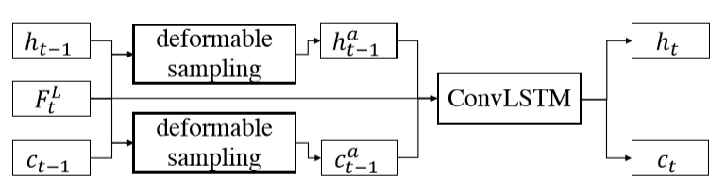
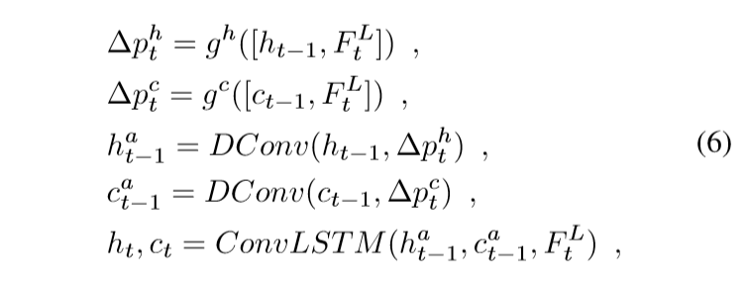
模型
Deformable ConvLSTM
Notes:
It has been proved in previous video restoration tasks [40, 34, 37] that temporal information is vital. Therefore, rather than reconstructing HR frames from the corresponding individual feature maps, we aggregate temporal contexts from neighboring frames.
ConvLSTM can only implicitly capture motions between previous states: ht−1 and ct−1 and the current input feature map with small convolution receptive ﬁelds. Therefore, ConvLSTM has limited ability to handle large motions in natural videos.

Slide 27
模型
Deformable ConvLSTM
We use the Deformable ConvLSTM in a bidirectional manner^{[13]}.
^{[13]} Mike Schuster and KuldipK Paliwal. Bidirectional recurrent neural networks. IEEE Transactions on Signal Processing 1997

Slide 28
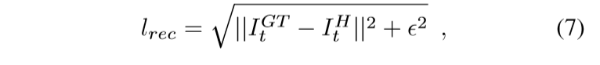
模型
Frame Reconstruction
Notes:
Charbonnier penalty function 沙博尼耶

Slide 29
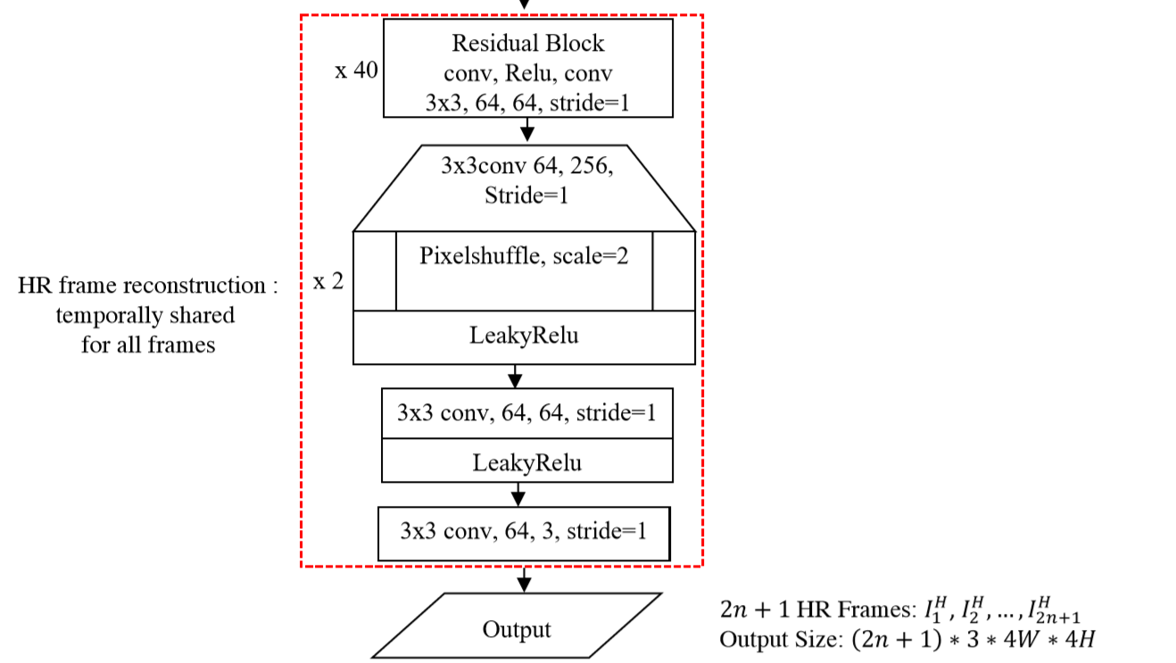
模型
Frame Reconstruction

Slide 30
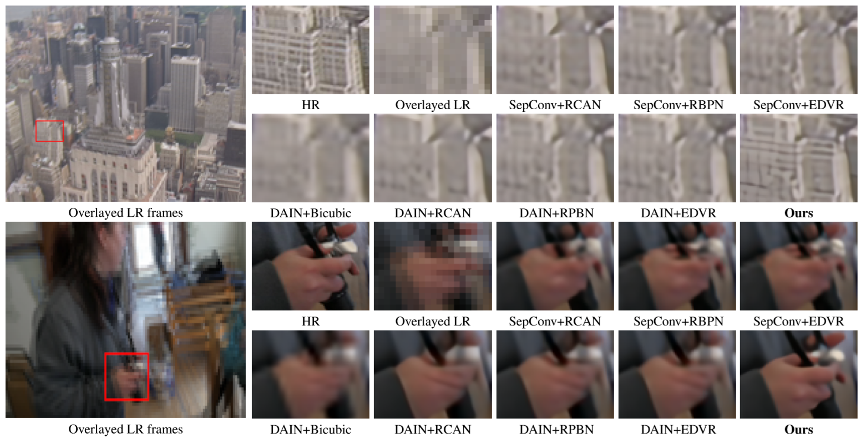
实验

Slide 31
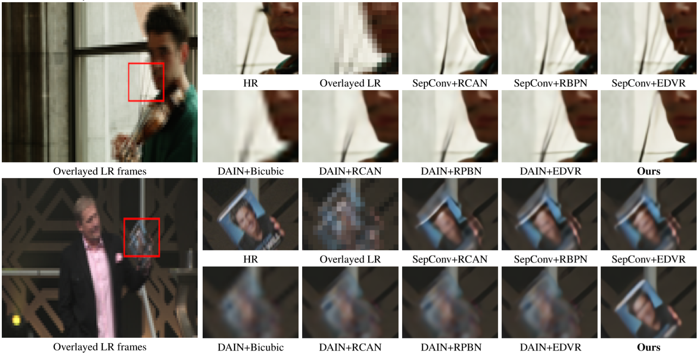
实验

Slide 32
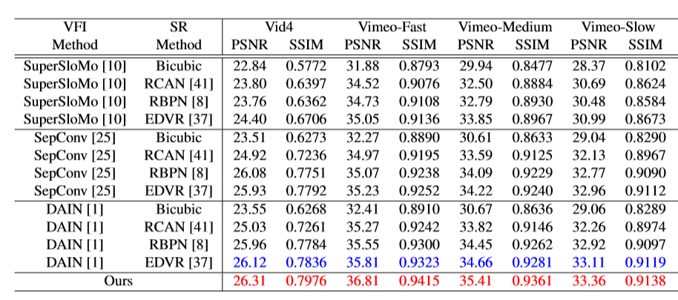
实验

Slide 33
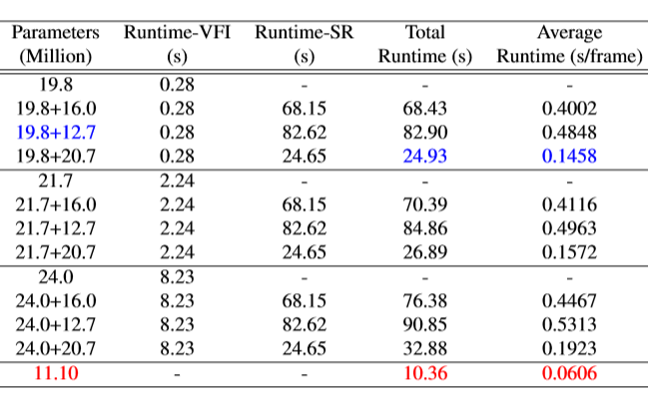
实验

Slide 34
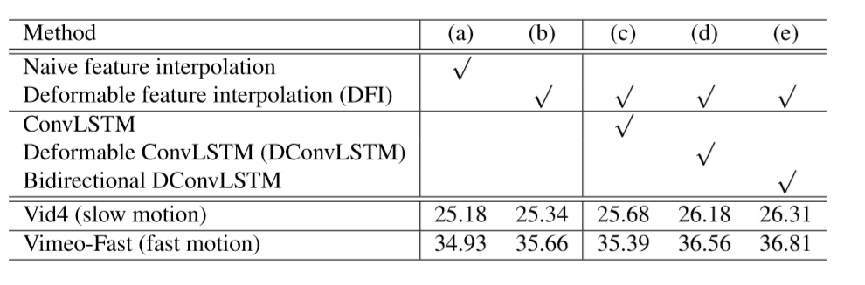
实验
Notes:
为了验证可变性ConLSTM的能力（Deformable ConvLSTM），实验比较了（b），（c），（d），（e）四个网络结构。（c）使用了原始的ConvLSTM结构，（d）使用了提出的DConvLSTM，（e）在（d）上使用了双向LSTM机制。
从图中，我们可以看到（c）在具有慢动作视频的Vid4上胜过（b），而比（b）在具有快速运动序列的Vimeo-Fast上差。 结果验证了原始ConvLSTM可以为慢动作视频利用有用的全局时间上下文，但不能处理视频中的大运动。 此外，我们观察到（d）比（b）和（c）都明显好，这表明我们的DConvLSTM可以成功地学习之前状态和当前特征图之间的时间对齐。 因此，它可以更好地利用全局上下文来重建具有更多细节的帧。 图4-3中的视觉结果进一步支持了我们的发现。

Slide 35
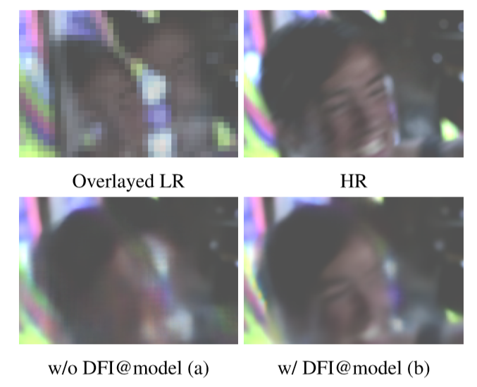
实验
Notes:
表4-1中有两个基准线。一个是（a）它没有用可变形的采样函数（Deformable Sampling Function）来提取低分辨率（LR）的特征，而是使用普通的卷积来提取特征。另一个是（b）它使用了可变形的采样函数（Deformable Sampling Function）来提取低分辨率（LR）的特征。
从图中可以知道（b）在Vid4和Vimeo-Fast上分别超出（a）0.16dB和0.73dB，图4-2中也展示了比较（a）和（b）的结果，我们可以看到，
（a）产生的人脸具有严重的运动模糊现象，而所提出的利用局部时域上下文的可变形特征插值可以有效解决大型运动问题，并有助于模型（b）生成具有更清晰人脸结构和细节的帧。所提出的DFI模块的优越性表明，即使在没有任何明确监督的情况下，在可变形采样函数中学习到的偏移量也可以有效地利用局部时间上下文，并成功捕获向前和向后的运动。

Slide 36
实验
Notes:
为了验证可变性ConLSTM的能力（Deformable ConvLSTM），实验比较了（b），（c），（d），（e）四个网络结构。（c）使用了原始的ConvLSTM结构，（d）使用了提出的DConvLSTM，（e）在（d）上使用了双向LSTM机制。
从图中，我们可以看到（c）在具有慢动作视频的Vid4上胜过（b），而比（b）在具有快速运动序列的Vimeo-Fast上差。 结果验证了原始ConvLSTM可以为慢动作视频利用有用的全局时间上下文，但不能处理视频中的大运动。 此外，我们观察到（d）比（b）和（c）都明显好，这表明我们的DConvLSTM可以成功地学习之前状态和当前特征图之间的时间对齐。 因此，它可以更好地利用全局上下文来重建具有更多细节的帧。 图4-3中的视觉结果进一步支持了我们的发现。

Slide 37
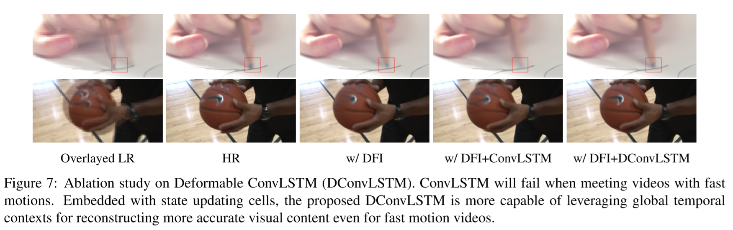
实验
Notes:
为了验证可变性ConLSTM的能力（Deformable ConvLSTM），实验比较了（b），（c），（d），（e）四个网络结构。（c）使用了原始的ConvLSTM结构，（d）使用了提出的DConvLSTM，（e）在（d）上使用了双向LSTM机制。从图中，我们可以看到（c）在具有慢动作视频的Vid4上胜过（b），而比（b）在具有快速运动序列的Vimeo-Fast上差。
结果验证了原始ConvLSTM可以为慢动作视频利用有用的全局时间上下文，但不能处理视频中的大运动。 此外，我们观察到（d）比（b）和（c）都明显好，这表明我们的DConvLSTM可以成功地学习之前状态和当前特征图之间的时间对齐。 因此，它可以更好地利用全局上下文来重建具有更多细节的帧。 图4-3中的视觉结果进一步支持了我们的发现。

Slide 38
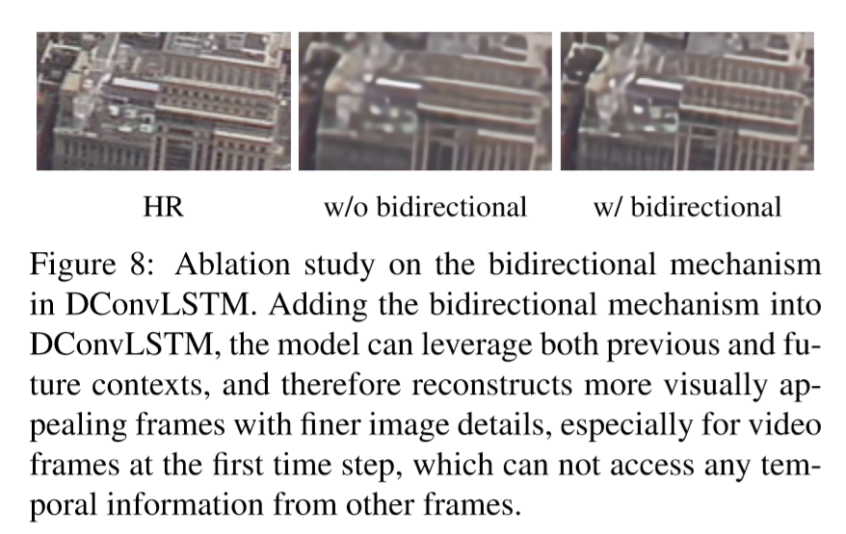
实验
Notes:
此外，我们比较了表4-2和图4-4中的（e）和（d），以验证DConvLSTM中的双向机制。 从表4-2中我们可以看出，在慢动作和快动作测试集上，（e）都可以比（d）进一步提高时空视频超分辨率（STVSR）性能。 图8中的视觉结果进一步表明，具有双向机制的模型可以通过为所有输入视频帧充分利用全局时间信息来恢复更多的视觉细节。

Slide 39
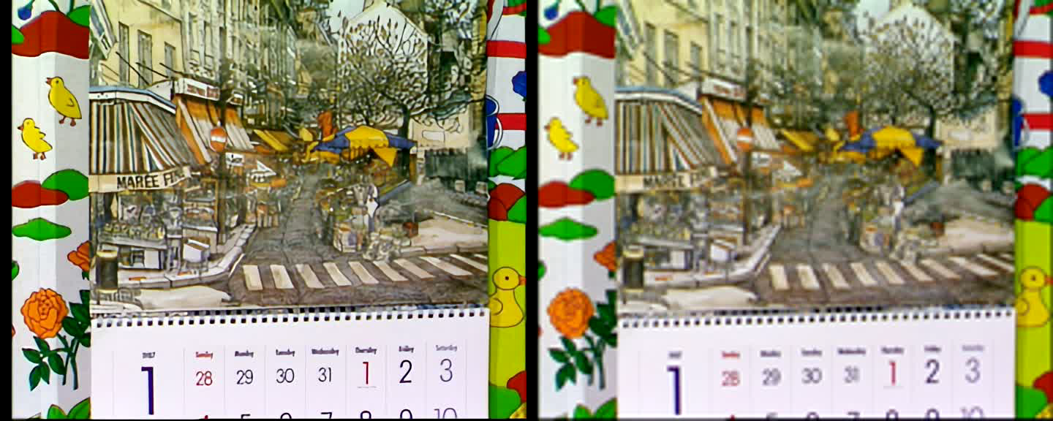
实验
Vid4

Slide 40
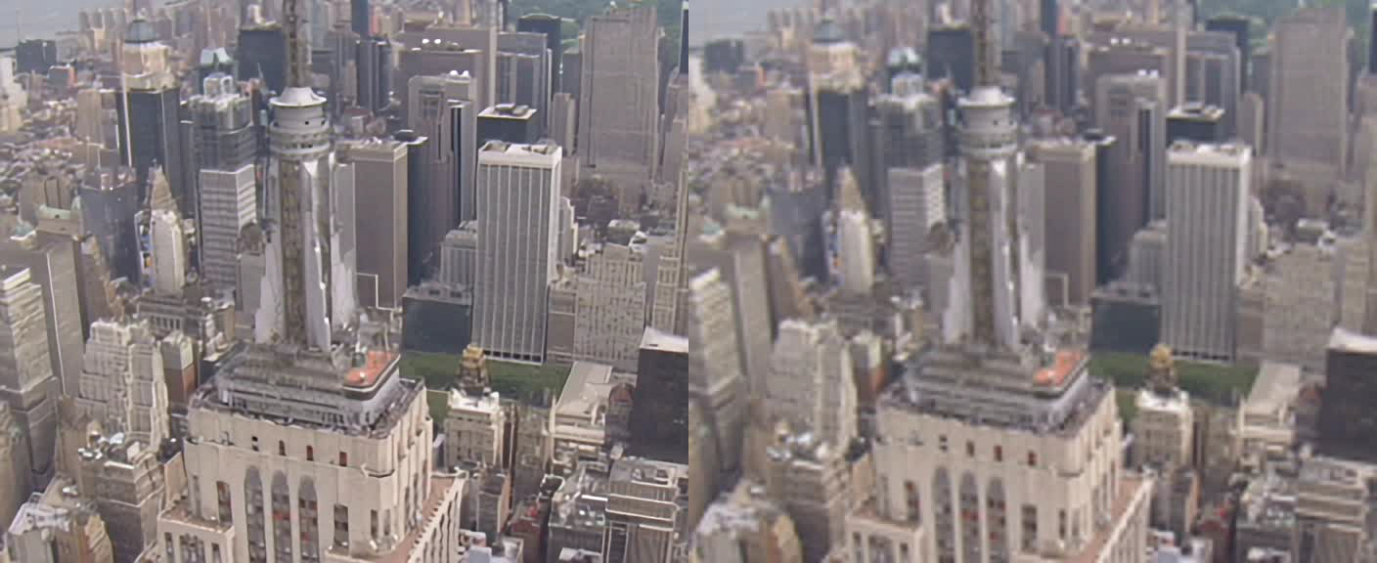
实验
Vid4

Slide 41
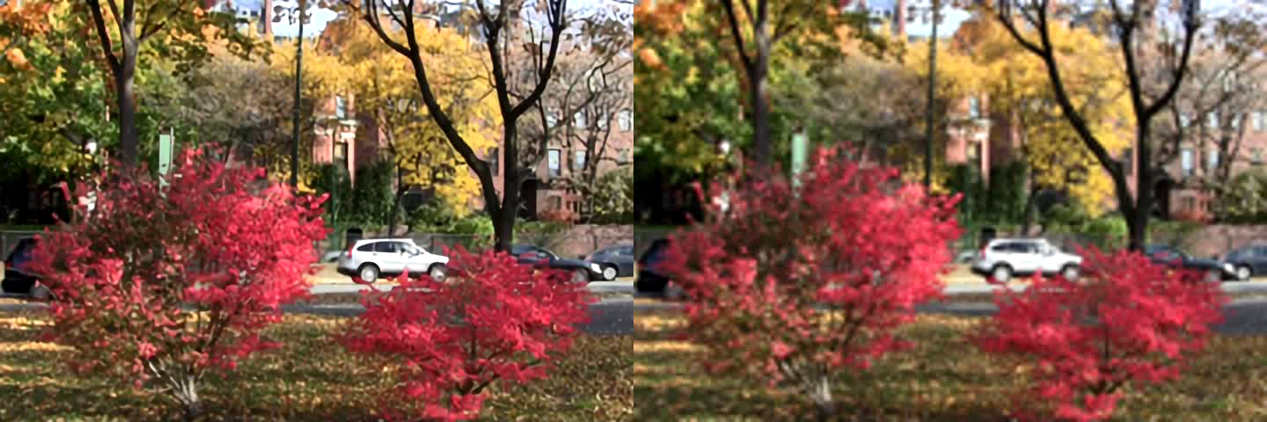
实验
Vid4

Slide 42
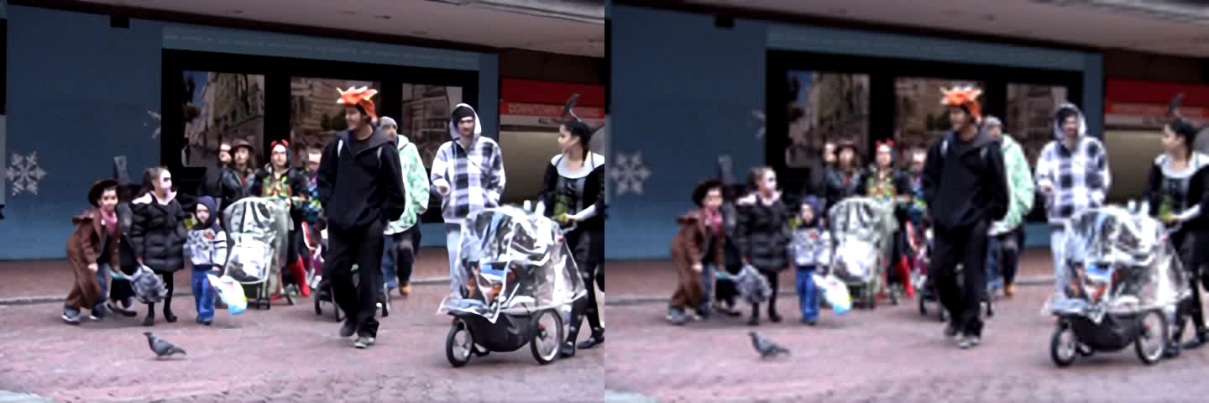
实验
Vid4

Slide 43

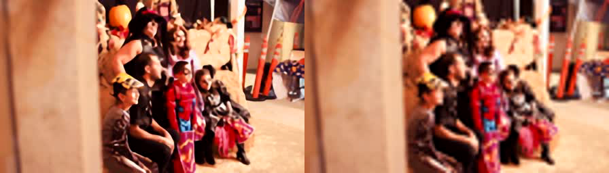
实验
Vimeo-slow

Slide 44

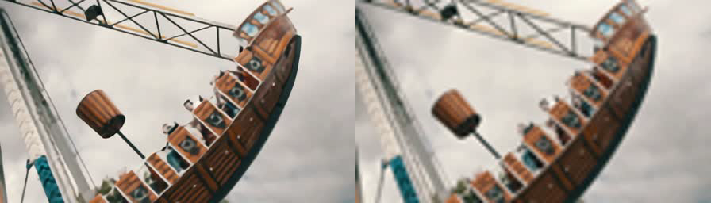
实验
Vimeo-medium

Slide 45

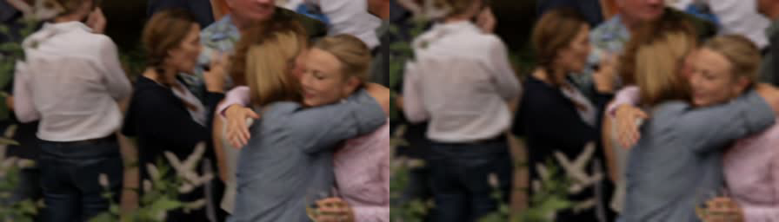
实验
Vimeo-fast

Slide 46
结论
A one-stage framework for space-time video super-resolution
Deformable feature interpolation network
Deformable ConvLSTM
Extensive experiments show that our one-stage frame work is more effective yet efﬁcient than existing two-stage networks.
Notes:
deformable feature interpolation network for feature-level temporal interpolation
A deformable ConvLSTM for aggregating temporal information and handling motions

Slide 47
谢谢

